Slide 1
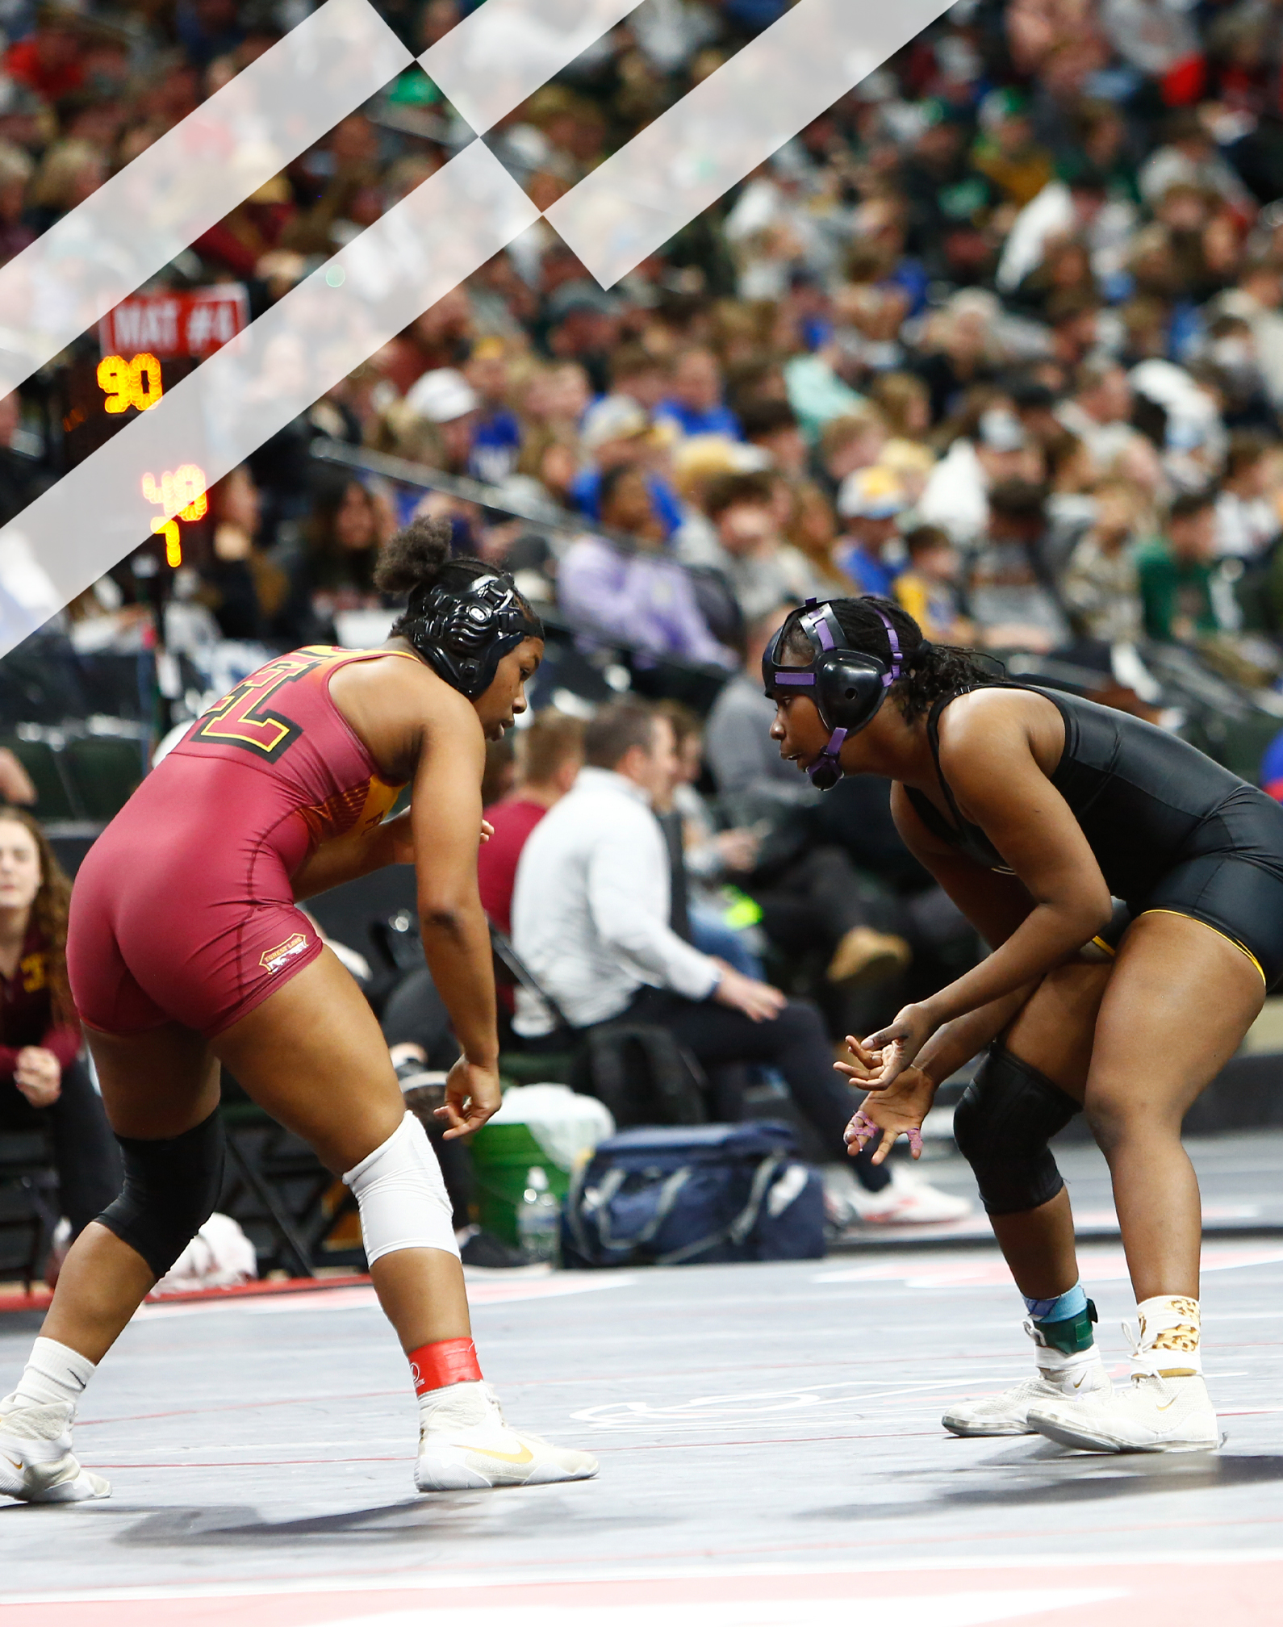

2025 - 2026 NFHS
Wrestling
Rules Changes
B. Elliot Hopkins, MLD, CAA
Director of Sports, Sanctioning and Student Services

Slide 2
2025 - 2026 NFHS Wrestling
Rules Changes

Slide 3
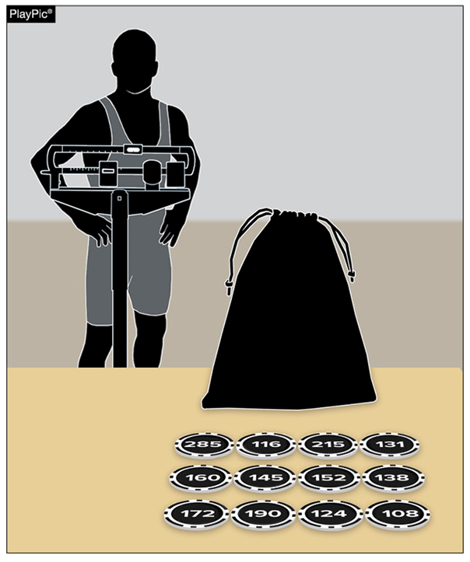
RULE 1-2-2 DUAL MEET
Notes:
RULE 1-2-2 NOW SAYS A DUAL MEET HAS TWO OPTIONS FOR DETERMINING THE ORDER OF WEIGHT CLASSES.
EITHER CONDUCT THE TRADITIONAL RANDOM DRAW OR … SIMPLY START AT THE LIGHTEST WEIGHT CLASS AND END AT THE HEAVIEST WEIGHT CLASS. THE HOST SCHOOL DECIDES WHICH OPTION TO USE.

Slide 4
RULE 1-2-2 DUAL MEET
ART. 2 . . . Competition in dual meets shall be conducted by random draw of weight classes, or lowest weight to heaviest. In multi-dual events, the sequence determined by the draw will be followed for that day's subsequent meet competition; the subsequent dual meet shall begin one weight class beyond the starting weight class of the previous round. The following procedure shall be used for the optional random draws:
a. The random draw shall take place immediately preceding weigh-ins.
b. The referee or other authorized person shall supervise the random draw.
c. Subsequent matches will follow in sequential order.
Notes:
THE UNDERLINED LANGUAGE IS NEW IN THE RULE BOOK.

Slide 5
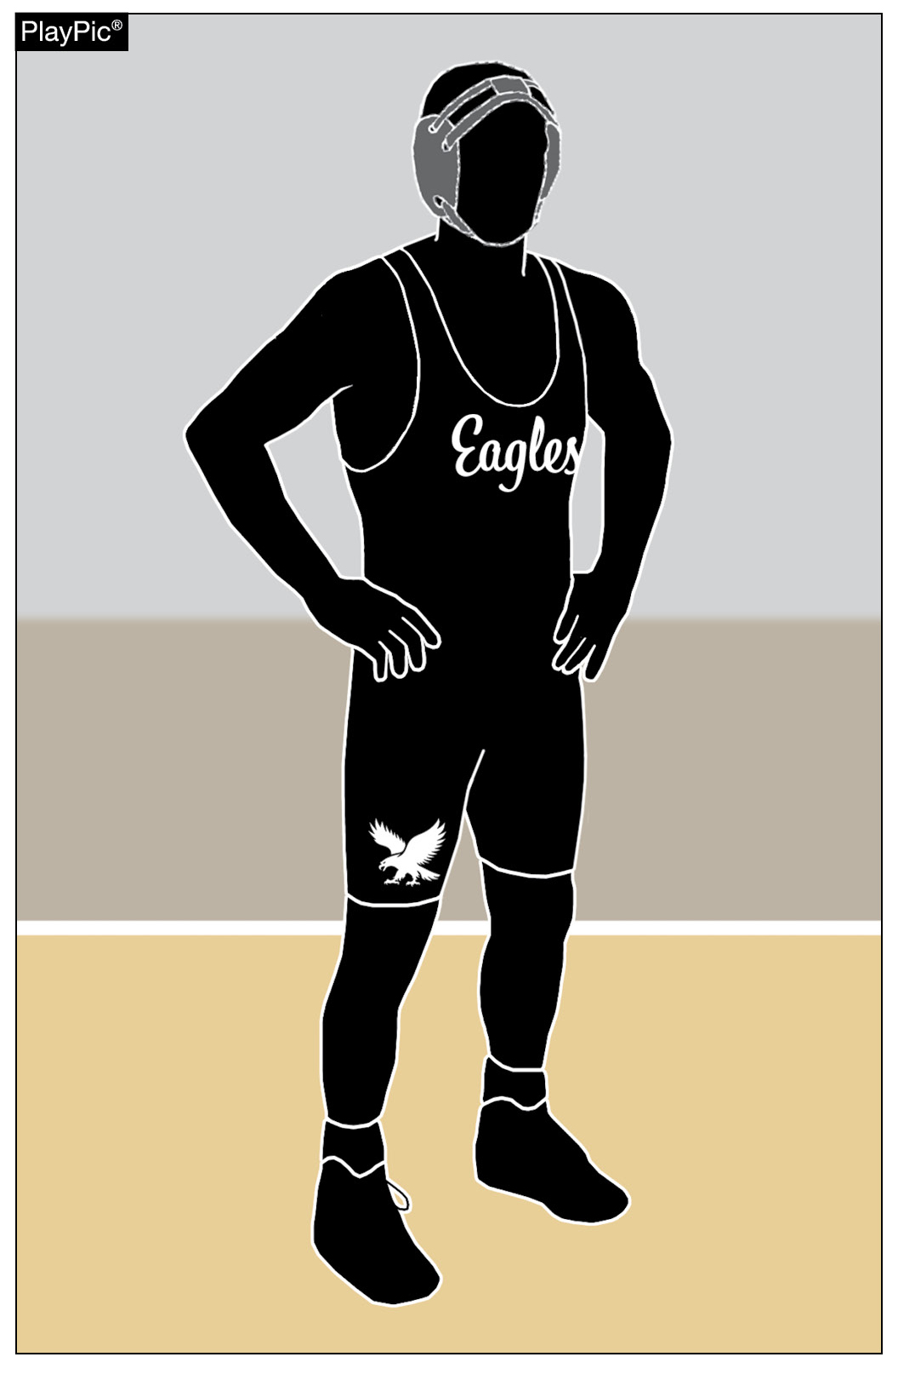
RULE 4-1-2 WRESTLERS’ UNIFORM
Notes:
RULE 4-1-2 DETAILS SOME CHANGES REGARDING WHAT IS ALLOWED ON A WRESTLING UNIFORM’S TOP AND/OR BOTTOM, INCLUDING: THE SCHOOL’S NAME, NICKNAME, LOGO, MASCOT, ALONG WITH THE WRESTLER’S NAME AND WEIGHT CLASS. A WRESTLER’S NICKNAME IS NOT ALLOWED ON THE UNIFORM.

Slide 6
RULE 4-1-2 WRESTLERS’ UNIFORM
ART. 2 . . The school's name, school nickname, school logo, school mascot, weight classification and/or the wrestler's name are permitted on the uniform top and/or bottom. Any manufacturer logo/trademark/reference that appears on the wrestling uniform, including legal hair covering can be no more than 2 1/4 square inches with no dimension more than 2 1/4 inches and may appear no more than once on each item of uniform apparel. No additional manufacturer's logo/trademark/or promotional reference shall be allowed on the wrestling uniform.
Rationale:
This is a universal rule adaptation by every NFHS Rules Committee to be uniformed for every NFHS rule publication.
Notes:
ONE KEY REASON FOR THE CHANGE IS TO CREATE CONSISTENCY IN WHAT IS ALLOWED ON UNIFORMS IN ALL HIGH SCHOOL SPORTS.

Slide 7
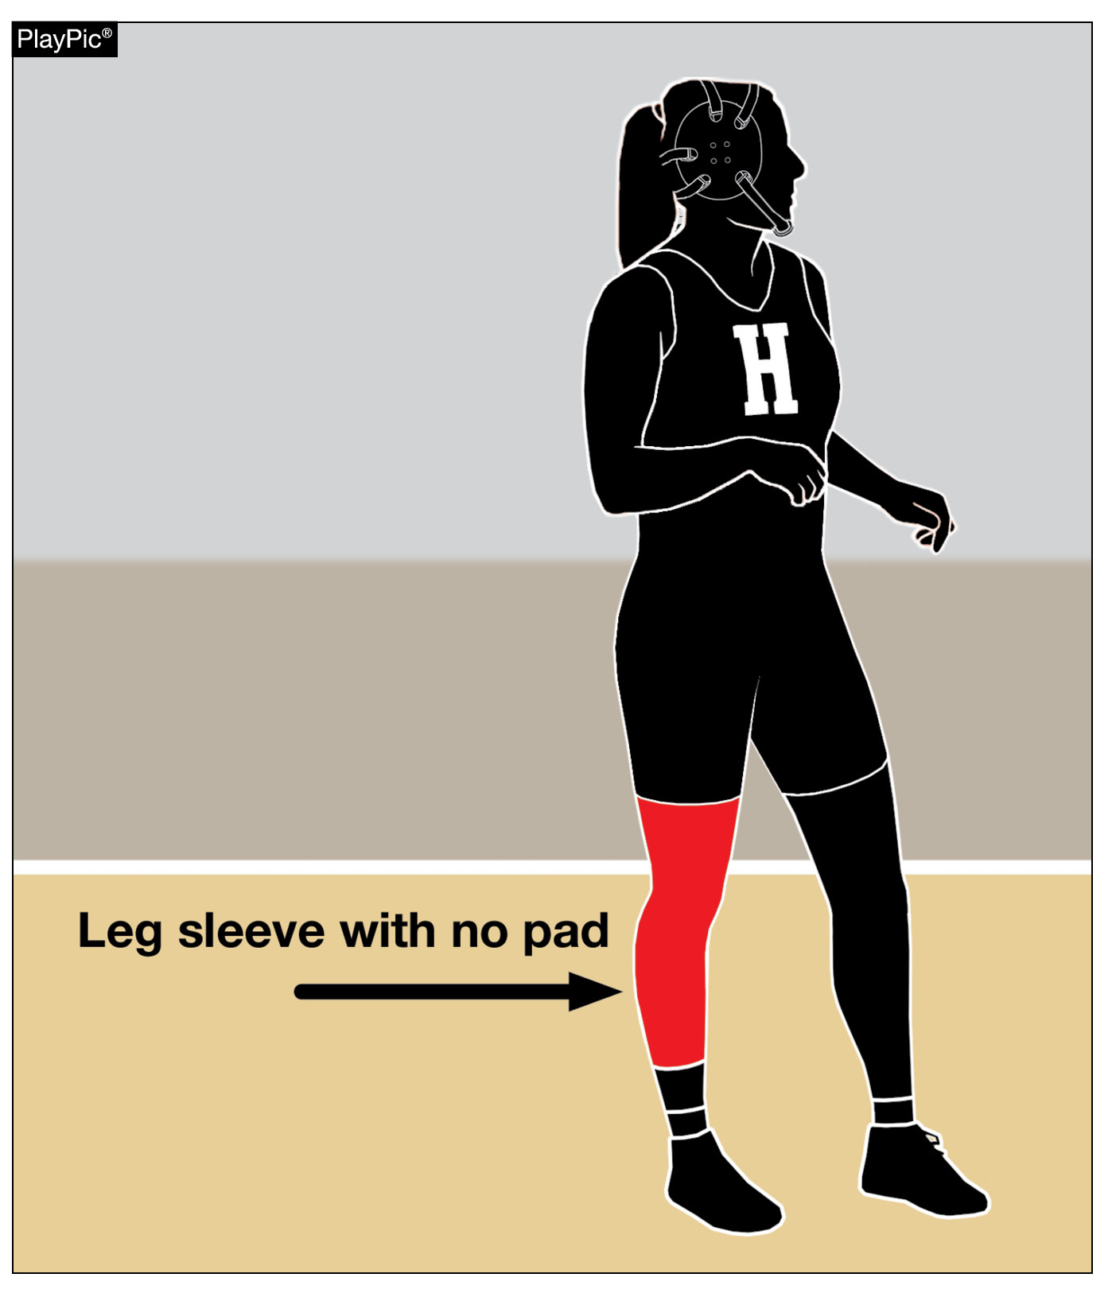
RULE 4-3-5 SPECIAL EQUIPMENT
Notes:
RULE 4-3-5 REGARDING SPECIAL EQUIPMENT USED TO REQUIRE A PAD IN A LEG SLEEVE. THE RULE NOW ALLOWS A WRESTLER TO WEAR A LEG SLEEVE WITHOUT A PAD.

Slide 8
RULE 4-3-5 SPECIAL EQUIPMENT
ART. 5 . . . Wrestlers shall not wear wristbands, sweatbands, bicep bands or leg or arm sleeves that do not contain a pad during a match.
Rationale:
We allow wrestlers to wear tights on both legs and that is no different than a sleeve on one leg. Requiring a pad on these sleeves serves no purpose other than additional equipment monitoring for the officials. It has no negative effect on the opponent.
Notes:
THE RATIONALE FOR THIS CHANGE IS THAT WRESTLERS ARE ALLOWED TO WEAR TIGHTS, SO A SLEEVE WITHOUT A PAD IS ESSENTIALLY THE SAME AS WEARING TIGHTS.

Slide 9
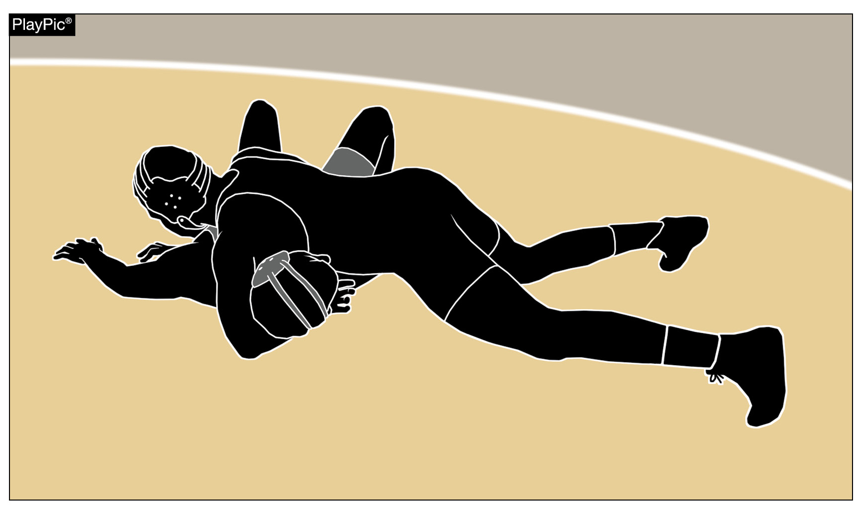
RULE 5-11-2c, 5-11-4b FALL, NEAR FALL & TECHNICAL FALL
Notes:
RULES 5-11-2 c. & 5-11-4 b. ABOUT A FALL, NEAR FALL, & TECH FALL HAVE NEW LANGUAGE.

Slide 10
RULE 5-11-2c, 5-11-4b FALL, NEAR FALL & TECHNICAL FALL
ART. 2 . . . A near fall occurs when the offensive wrestler has control of the opponent in a pinning situation and near-fall criteria are met for a period of two seconds or longer. (Photos 5-6)
a.- b. Remain the same.
c. A near fall is ended when the defensive wrestler gets out of a pinning situation. The referee must not signal the score for a near fall until the situation is ended and only one near fall shall be scored in each pinning situation, regardless of number of times the offensive wrestler places an opponent in the near-fall position criteria during the pinning situation. If the near-fall creates a 15-point advantage, the match shall continue until the near-fall criteria is no longer met. Conclusion of the near-fall criteria is immediate.
d.- i. Remain the same.
Notes:
IN SIMPLEST TERMS: WHEN A WRESTLER IS AHEAD BY AT LEAST 15 POINTS, AND THE WRESTLERS ARE IN A NEAR-FALL POSITION, THE OFFICIAL WILL ALLOW WRESTLING TO CONTINUE TO ALLOW THE OFFENSIVE WRESTLER THE OPPORTUNITY TO EARN A FALL. IF WRESTLING CONTINUES, AND AT SOME POINT DURING THE ACTION, NEAR-FALL CRITERIA IS NO LONGER MET, THE OFFICIAL WILL STOP THE MATCH FOR A TECH FALL.

Slide 11
RULE 5-11-2c, 5-11-4b FALL, NEAR FALL & TECHNICAL FALL
ART. 4 . . . A technical fall occurs when a wrestler has earned a 15-point advantage over the opponent, however;
if a takedown or reversal, straight to a near-fall criteria creates a 15-point advantage, the match shall continue until the near-fall criteria is no longer met. Conclusion of the near-fall criteria is immediate.
once the technical fall has been earned, the offensive wrestler cannot lose the match. If a near-fall creates a 15-point advantage, the match shall continue until the near-fall criteria is no longer met. Conclusion of the near-fall criteria is immediate.

Slide 12
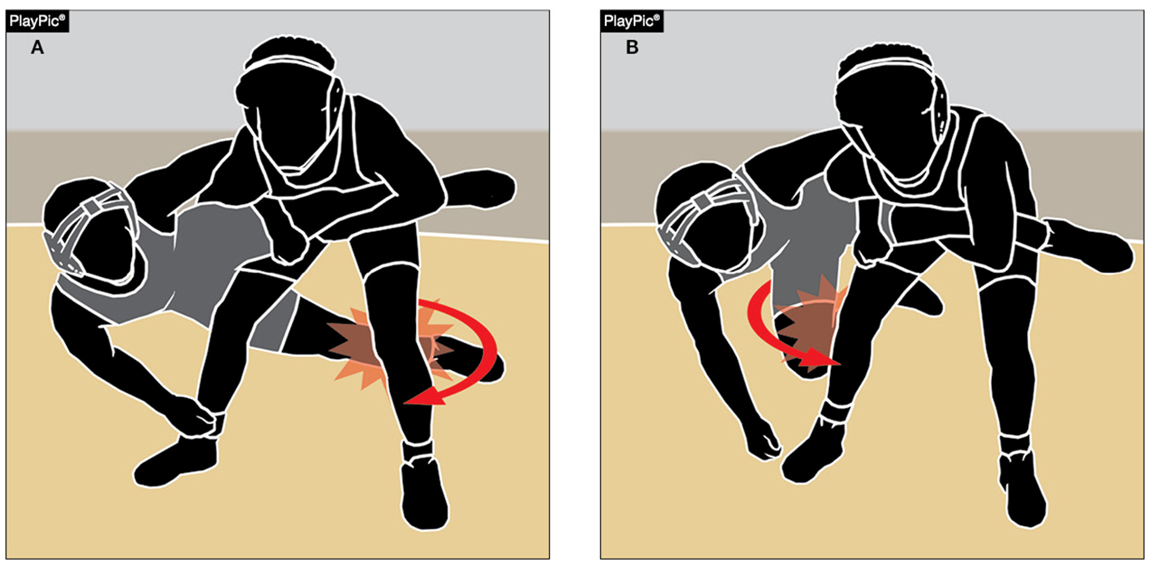
ILLEGAL HOLDS/MANEUVERS
7-1-5n
Notes:
RULE 7-1-5 n. HAS NEW LANGUAGE THAT CLARIFIES THE ILLEGAL “CUT BACK” MOVE.

Slide 13
RULE 7-1-5n ILLEGAL HOLDS/MANEUVERS
n. leg block (cut-back) when leaving the feet and using the foot or leg to "cut out" an opponent’s leg, to include from the rear-standing position.
Rationale:
This rule change seeks to clarify language regarding the leg block or "cut-back". When applied the move/maneuver can cause significant injury to the defensive wrestler lower extremities. The NFHS is now aligned with other rules codes to clarify this illegal maneuver.
Notes:
A WRESTLER CAN’T LEAVE HIS OR HER FEET AND USE A FOOT OR LEG TO CUT OUT OPPONENT’S LEG OR LEGS, INCLUDING FROM THE REAR STANDING POSITION.
THE RATIONALE FOR THIS CHANGE IS TO ELIMINATE A MOVE THAT CAN CAUSE SIGNIFICANT INJURY TO THE DEFENSIVE WRESTLER’S LEG.

Slide 14
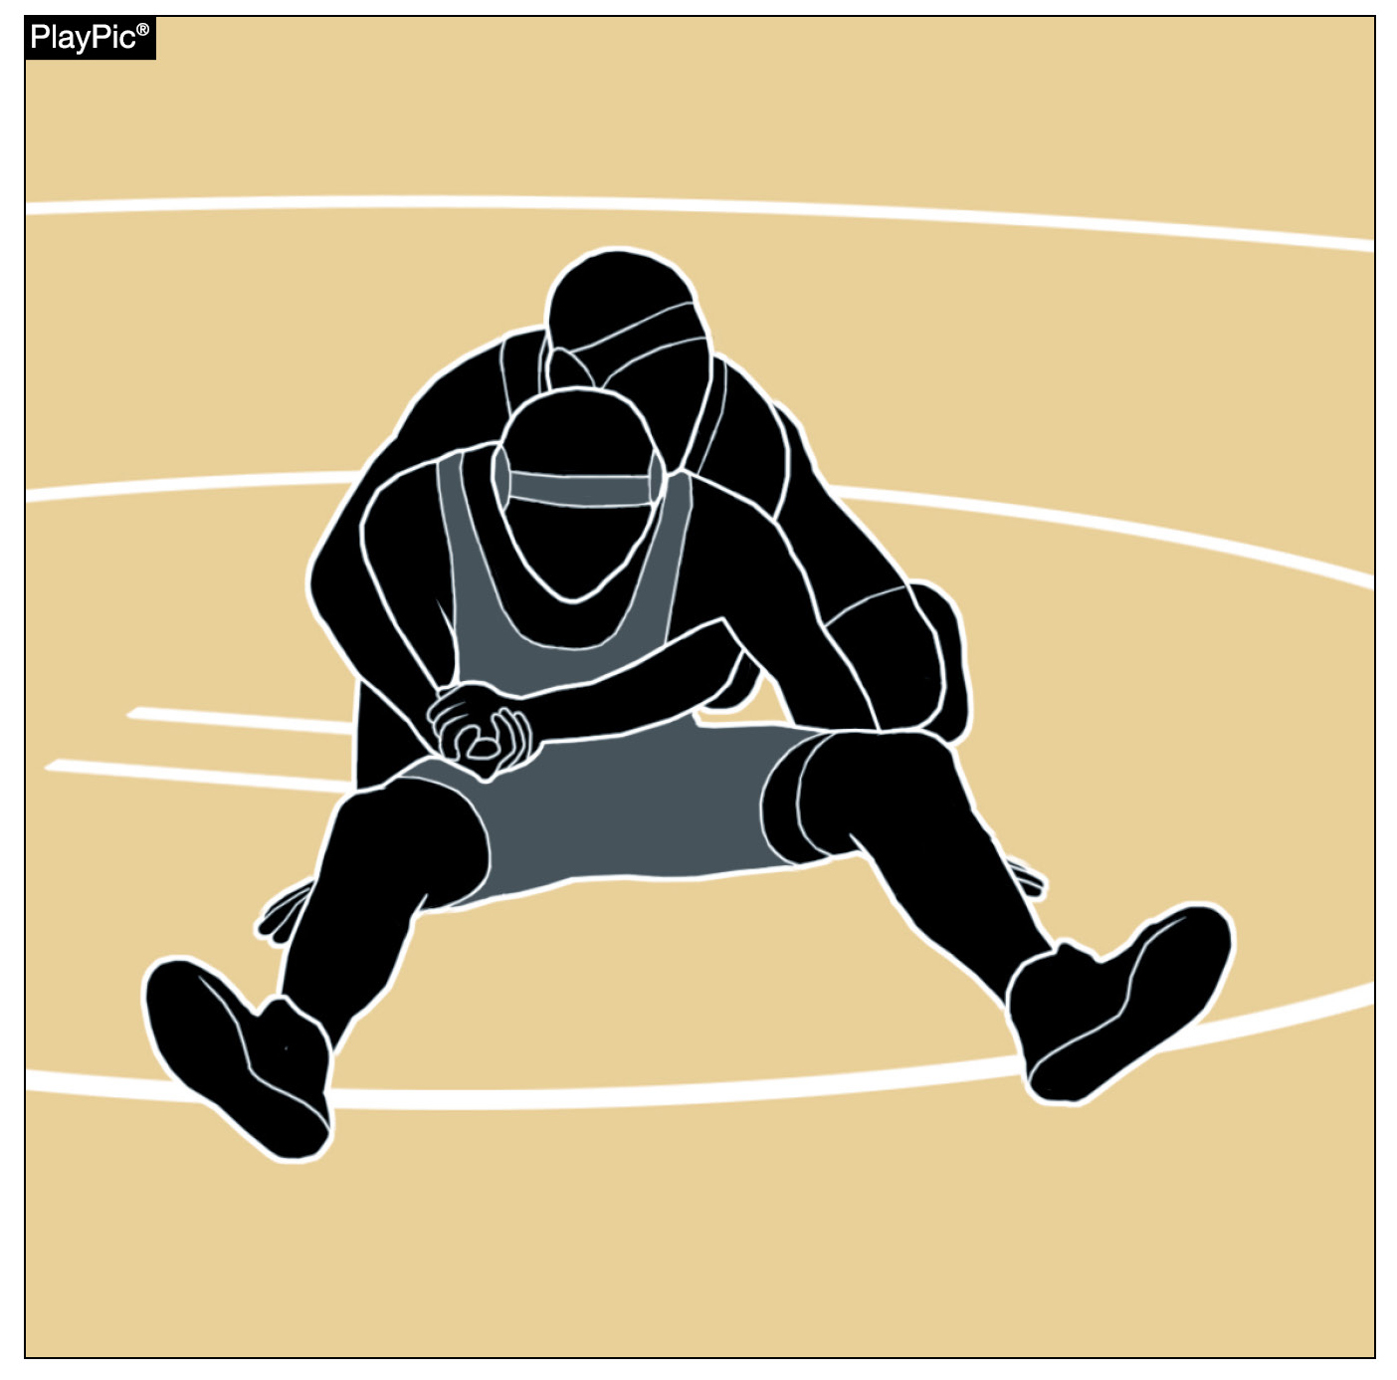
TECHNICAL VIOLATIONS
7-3-3
Notes:
RULE 7-3-3 ABOUT A TECHNICAL VIOLATION FOR LOCKED HANDS HAS CHANGED THE WORD “ARM” TO “EXTREMITY”.

Slide 15
RULE 7-3-3 TECHNICAL VIOLATIONS
ART. 3 . . . Interlocking or overlapping the hands, fingers or arms around the opponent's body (with or without an extremity arm included) or both legs by a wrestler in the advantage position, unless the opponent has all the weight supported entirely by the feet or has lifted the opponent off the mat or the opponent has met near-fall criteria, is a technical violation and the penalty point(s) shall be awarded in addition to points earned. (When bringing your opponent to the mat, hands overlapping or interlocking beyond reaction time is a technical violation.) (Photos 103-106)
Rationale:
Locking hands and including a leg in the clasp around the trunk of the body is the same as locking hands with an arm included.
Notes:
HERE IS THE SPECIFIC RULE CHANGE FOR 7-3-3 AND ITS RATIONALE.
FOR THE PURPOSES OF THIS RULE, THE WORD “EXTREMITY” MEANS AN ARM OR A LEG.

Slide 16
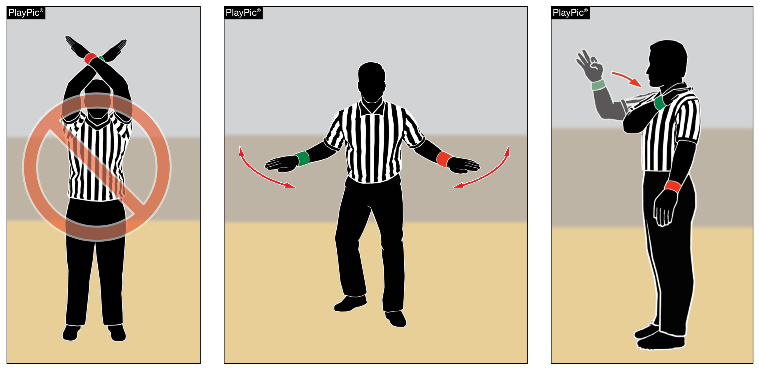
OFFICIAL WRESTLING SIGNALS
The former signal No. 3 (Officials Timeout) has been removed.
Signal No. 9 (No Control) has been modified to move the hands left to right instead of circular.
Signal No. 21 (Near Fall) has been modified so the number three is signaled as if making the “OK” sign.
Notes:
THREE OFFICIALS SIGNALS HAVE CHANGED.
THE FORMER “OFFICIALS TIMEOUT” SIGNAL HAS BEEN REMOVED FROM THE RULE BOOK.
THE “NO CONTROL” SIGNAL HAS BEEN EDITED TO HAVE THE OFFICIAL MOVE HIS OR HER HANDS LEFT TO RIGHT INSTEAD OF IN A CIRCULAR MOTION.
THE “NEAR FALL” SIGNAL NOW HAS THE OFFICIAL SIGNALLING 3 POINTS AS IF HE OR SHE IS MAKING THE “OK” SIGN.

Slide 17
Points of Emphasis

Slide 18
STATE SERIES CHANGES
Boys Regional January 31
Dual Team Sectional February 5
Girls Regional February 6 & 7
Boys & Girls Sectionals February 13 & 14
Boys Individual State Finals February 19-21
Girls Individual State Finals February 27 & 28
Dual Team State Finals February 27 & 28
Notes:
TWO YEARS AGO, THE WRESTLING ADVISORY COMMITTEE RECOMMENDED (AND THE IHSA BOARD OF DIRECTORS APPROVED) SOME STATE SERIES DATE CHANGES THAT TAKE EFFECT THIS SEASON. ESSENTIALLY, THE GIRLS & BOYS REGIONAL WEEKENDS FLIP-FLOP. THIS SEASON, THE BOYS REGIONAL IS SATURDAY, JANUARY 31. THE GIRLS REGIONAL IS A TWO-DAY TOURNAMENT - FRIDAY, FEBRUARY 6 & SATURDAY, FEBRUARY 7. ADDITIONALLY, THE DUAL TEAM SECTIONAL MOVED EARLIER ON THE CALENDAR. THE DUAL TEAM SECTIONAL IS NOW THURSDAY, FEBRUARY 5 … THE THURSDAY AFTER THE BOYS REGIONAL.

Slide 19
BODY FAT ASSESSMENT &
WEIGHT CONTROL PLAN
ALL wrestlers must have a body fat assessment and a weight control plan in TrackWrestling prior to competition.
Wrestlers must follow their weight control plan throughout the season.
Notes:
ALL WRESTLERS MUST HAVE THEIR BODY FAT ASSESSED AND HAVE A WEIGHT CONTROL PLAN IN TRACKWRESTLING PRIOR TO COMPETITION. THERE ARE NO EXCEPTIONS TO THIS RULE.

Slide 20
TRACKWRESTLING
ALL wrestlers must have a body fat assessment and a weight control plan in TrackWrestling prior to competition.
Wrestlers must follow their weight control plan throughout the season.

Slide 21
REGULAR SEASON MATCH LIMITS
Team schedule
Maximum 25 dates
  Each level of a school’s wrestling program can have a max of 25 dates.
  Boys Varsity, Girls Varsity, Boys JV, Girls JV, Freshman
Individual
Maximum 45 matches
  This includes matches at any level and matches when a wrestler accepts a forfeit win.
Notes:
IHSA BY-LAWS ESTABLISH SEASON LIMITS FOR TEAMS AND INDIVIDUALS.
EACH TEAM CAN HAVE A MAXIMUM OF 25 DATES ON ITS SCHEDULE. THAT MEANS IF A SCHOOL HAS MULTIPLE LEVELS OF WRESTLING, THE VARSITY, JV, AND FRESHMAN TEAMS CAN EACH SCHEDULE A MAX OF 25 DATES.
INDIVIDUALS ARE ALLOWED TO WRESTLE IN A MAXIMUM OF 45 REGULAR SEASON MATCHES PRIOR TO THE REGIONAL. ALL MATCHES ARE INCLUDED IN THIS TOTAL – VARSITY, JV, EXHIBITION, AND MATCHES WHEN A WRESTLER ACCEPTS A FORFEIT WIN.

Slide 22
GIRLS WRESTLING
If a school only has a boys team, girls are allowed to participate on the boys team because that’s their only option.
If a school schedules a girls-only event, that means the school has a girls team, even if that team is just one (or a few) girls.
Once the girls participate in that event, they can only participate in girls events the rest of the season.
Notes:
WITH THE RAPID GROWTH OF GIRLS WRESTLING, WE FREQUENTLY RECEIVE QUESTIONS ABOUT WHAT GIRLS ARE ALLOWED TO DO WHEN THEIR SCHOOL ONLY HAS A BOYS TEAM OR IF THE SCHOOL ONLY HAS A FEW GIRLS OUT FOR WRESTLING. IHSA POLICY 30 COVERS AFFIRMATIVE ACTION. IN THE FIRST FEW YEARS OF GIRLS WRESTLING, WE ALLOWED A LOT OF FLEXIBILITY WITH THIS POLICY BECAUSE IN MANY AREAS OF THE STATE, THE ONLY COMPETITION GIRLS COULD FIND AT THEIR WEIGHT CLASS WAS AGAINST BOYS.
NOW THAT WE’RE IN YEAR 5 OF A GIRLS STATE SERIES, SCHOOLS MUST FOLLOW POLICY 30 AS-WRITTEN. ESSENTIALLY, IT SAYS THIS:
IF A SCHOOL ONLY HAS A BOYS TEAM, GIRLS ARE ALLOWED TO PARTICIPATE ON THE BOYS TEAM BECAUSE THAT IS THEIR ONLY WRESTLING OPTION.
HOWEVER, IF A SCHOOL SCHEDULES A GIRLS-ONLY EVENT OR TOURNAMENT, THE SCHOOL IS DECLARING IT HAS A GIRLS TEAM (EVEN IF THAT TEAM IS ONLY A FEW GIRLS).
FROM THAT POINT FORWARD, THE SCHOOL’S GIRLS ARE ONLY ALLOWED TO WRESTLE AGAINST GIRLS IN COMPETITION.
FOR EXAMPLE: A SCHOOL HAS 2 GIRLS WHO WRESTLE. THE SCHOOL ENTERS THE GIRLS IN A GIRLS-ONLY TOURAMENT ON JANUARY 10. UP TO THAT POINT, THE GIRLS CAN WRESTLE AGAINST BOYS OR IN EXHIBITION MATCHES AGAINST GIRLS. HOWEVER, FROM JANUARY 10 UNTIL THE END OF THE SEASON, THE GIRLS CAN ONLY WRESTLE AGAINST OTHER GIRLS IN COMPETITION.
THERE’S ONE MORE PIECE TO THIS … EVEN IF GIRLS WRESTLE VS. OTHER GIRLS ALL SEASON, THEY CAN STILL PARTICIPATE IN THE DUAL TEAM SECTIONAL AND STATE FINALS SINCE THAT IS THE ONLY “TEAM” OPTION IN WRESTLING.

Slide 23
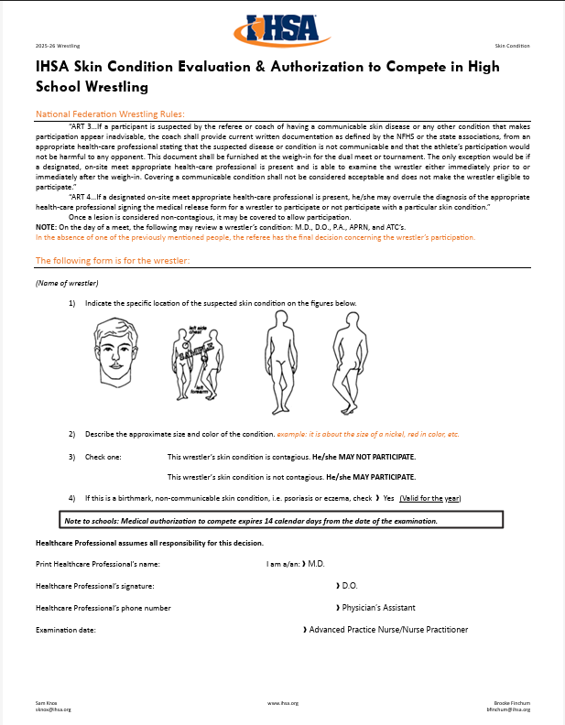
USE & NECESSITY
OF IHSA SKIN FORM
The NFHS Wrestling Skin Lesion Form is a critical document designed to promote student safety and prevent the spread of infectious skin diseases in wrestling.
This form provides standardized medical documentation that allows licensed medical professionals to evaluate skin lesions and determine whether an athlete is medically cleared to compete.
By requiring this form prior to participation, schools and state associations can ensure consistent, evidence-based decision-making while minimizing health risks to all competitors.
Notes:
WHEN A WRESTLER HAS A CONTAGIOUS SKIN CONDITION THAT NEEDS TO BE EXAMINED PRIOR TO COMPETITION, THE COACH MUST PROVIDE THE IHSA SKIN FORM TO THE OFFICIALS AND MEDICAL STAFF. KEEP IN MIND THAT IF A WRESTLER’S SKIN CONDITION IS NOT COMPLETELY HEALED OR IF HE OR SHE HAS A NEW SKIN CONDITION IN A DIFFERENT LOCATION THAT IS NOT DOCUMENTED ON THE FORM, OFFICIALS AND/OR AN ATHLETIC TRAINER HAVE THE AUTHORITY TO DETERMINE THE WRESTLER IS NOT ALLOWED TO PARTICIPATE.

Slide 24
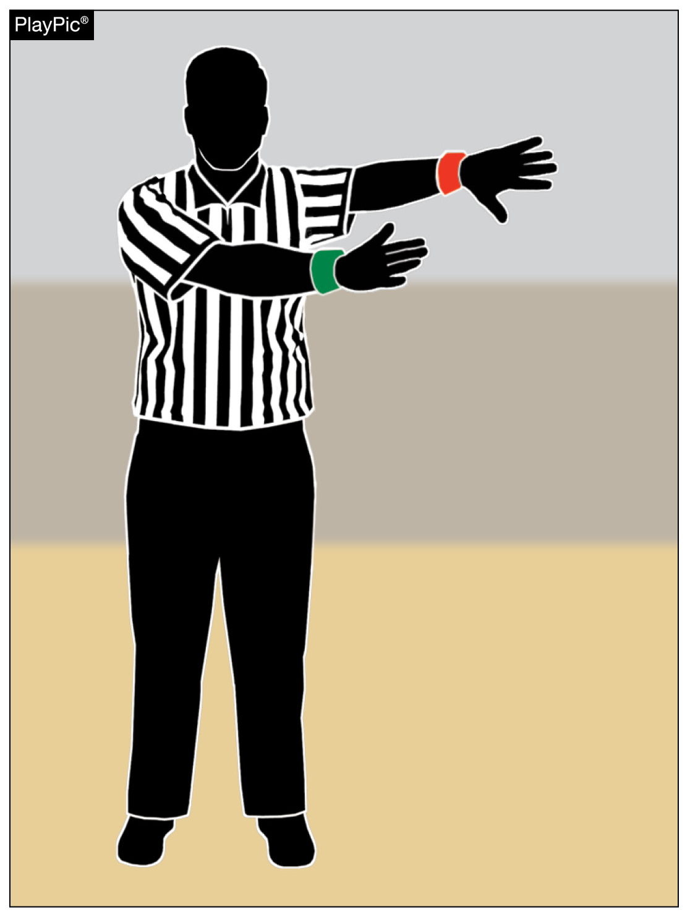
NFHS OFFICIAL WRESTLING SIGNALS — OUT OF BOUNDS
Notes:
OFFICIALS ARE NO LONGER REQUIRED TO RAISE A HAND TO STOP THE CLOCK PRIOR TO SIGNALLING THE WRESTLERS ARE OUT OF BOUNDS. OFFICIALS CAN SIMPLY USE THE SIGNAL YOU SEE HERE WHEN THEY MAKE THAT CALL.

Slide 25
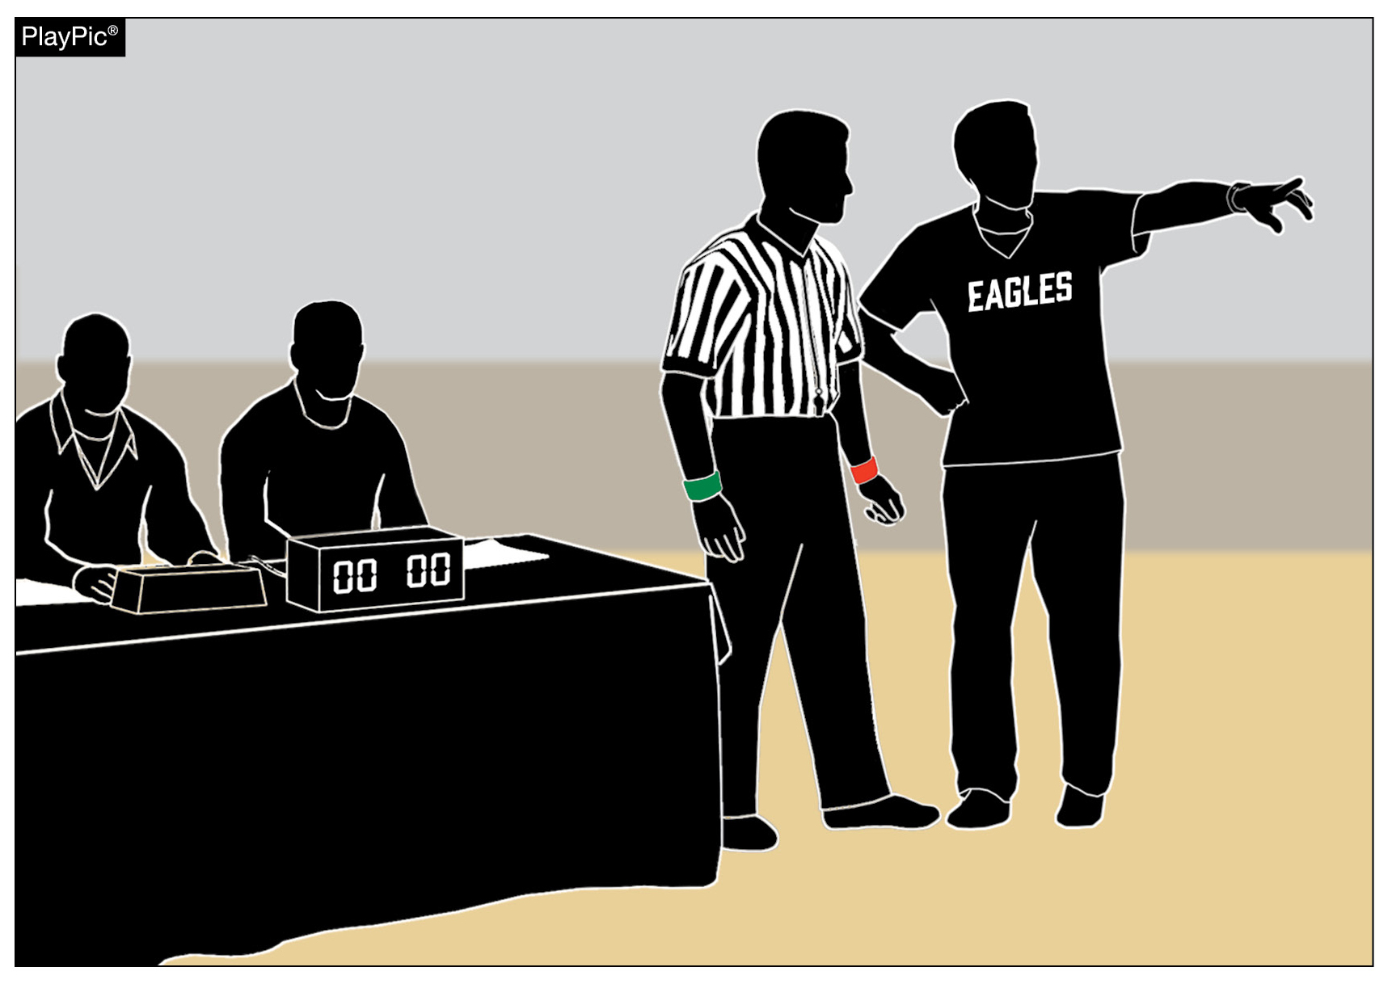
COACH MISCONDUCT PENALTY — CONSEQUENCES
Notes:
THERE IS A PROPER WAY FOR COACHES AND OFFICIALS TO COMMUNICATE … AND AN IMPROPER WAY. WHEN A COACH TAKES AN OFFICIAL TO THE TABLE TO DISCUSS A RULING, HE MUST KEEP SPORTSMANSHIP, INEGRITY, REPUTATION, AND TEAM SCORING CONSEQUENCES IN MIND.

Slide 26
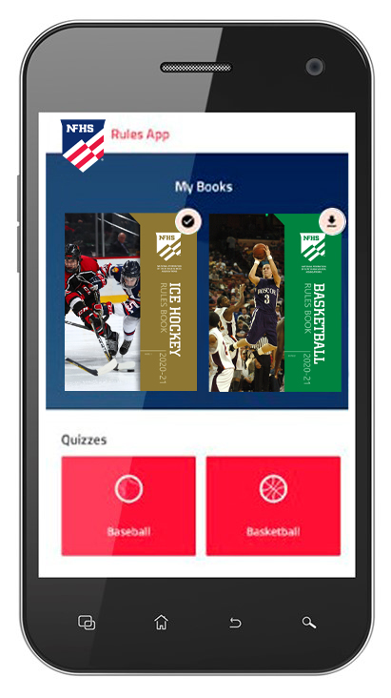
NEW NFHS Rules App
Rules App features:
  Searchable
  Highlight notes
  Bookmarks
  Easy navigation
  Immediate availability
  Free to paid members of the NFHS Coaches
  and Officials Associations
  https://support.nfhsdigital.org/ for more information
Notes:
FOR COACHES AND OFFICIALS WHO WOULD LIKE TO HAVE THE RULE BOOK ON THEIR PHONE, THE NEW NFHS RULES APP IS AVAILABLE ON iTunes & Google Play.
THE APP IS FREE TO DOWNLOAD.
WITHIN THE APP, EACH RULE BOOK COSTS $6.99.

Slide 27

Notes:
THE NFHS LEARNING CENTER PROVIDES COACHES AND OFFICIALS WITH TERRIFIC OPPORTUNITIES TO IMPROVE THEIR KNOWLEDGE & SKILLS.

Slide 28

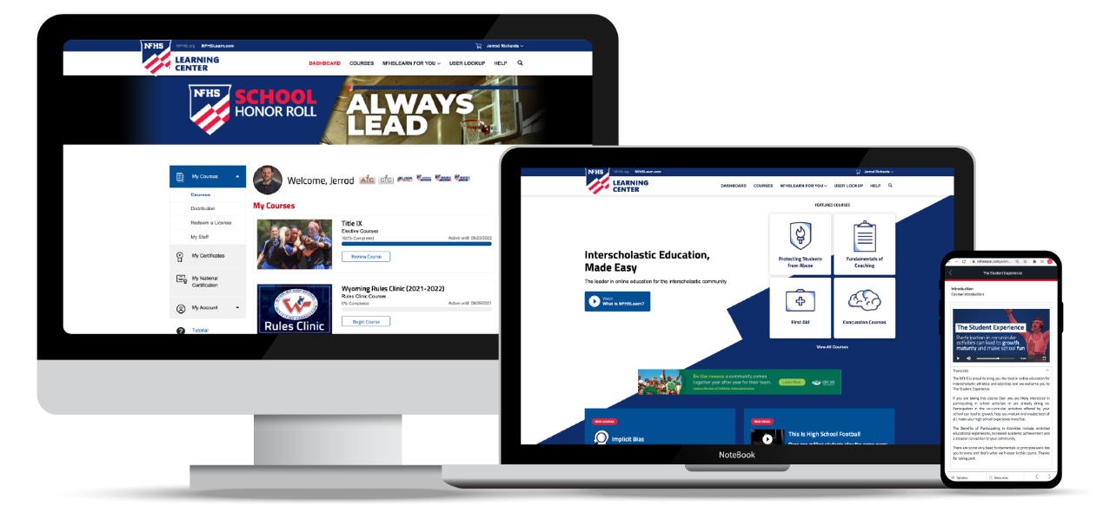
Over 21 million courses delivered!
Concussion in Sports – 7.2M+
Heat Illness Prevention – 2.2M+
Sudden Cardiac Arrest – 2.4M+
Concussion for Students – 1.2M+
The Collapsed Student (2020) – 67,550+
CPR & AED Training (2023) – 9,300+
Sportsmanship – 1M+
Fundamentals of Coaching – 928,000+
First Aid, Health and Safety – 418,000+
Bullying, Hazing and Inappropriate Behaviors – 425,000+
Student Mental Health and Suicide Prevention – 250,000+
Protecting Students from Abuse – 250,000+
Implicit Bias (2021) – 96,000+
Notes:
NFHSLEARN.COM OFFERS MORE THAN 100 COURSES ON A VARIETY OF TOPICS FOR ALL AUDIENCES.
MORE THAN 60 COURSES ARE FREE.

Slide 29





OFFICIALS EDUCATION
Content remains free of charge
TEACHING
AIDS
RULES
CHANGES
DIAGRAMS
VIDEO
LIBRARY
OFFICIALS
COURSES
Notes:
ADDITIONALLY, MANY OFFICIALS COURSES IN A VARIETY OF SPORTS ARE FREE.
VISIT NFHSLEARN.COM FOR MORE INFORMATION.

